Slide 1
Some Examples of Direct Manipulation
Geographical systems including GPS (global positioning systems)
Video games
Computer-aided design and fabrication
Direct-manipulation programming and configuration

Slide 2
Geographical systems including GPS (global positioning systems)
For centuries, travelers have relied on maps and globes to better understand the Earth and geographical systems. As graphic- and image-capture capabilities increased (both real-world and human-generated), it was a natural progression to create systems to represent both a current location—”where we are”—and a target location—”where we want to go.” Of course, as prices dropped, these types of systems became available as commercial GPS systems for cars, for walking, and even for the mobile phone. Being able to directly see the alternatives on the devices as well as how to move from the current location to the target location including manipulating the routes is another application of direct manipulation.
Google Maps™, MapQuest, Google Street View, Garmin, National Geographic, and Google Earth™ combine geographic information from aerial photographs, satellite imagery, and other sources to create a vast database of graphical information that can easily be viewed and displayed.

Slide 3
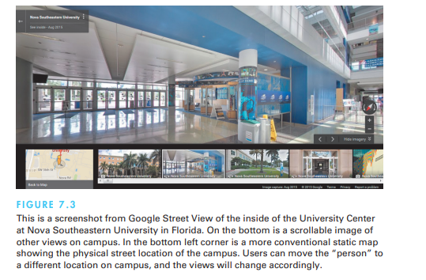

Slide 4
Video games
For many people, the most exciting, well-engineered, and commercially successful application of the direct-manipulation concepts lies in the world of video games. The early but simple and popular game Pong® (created in 1972) required the user to rotate a knob that moved a white rectangle on the screen. A white spot acted as a ping-pong ball that ricocheted off the wall and had to be hit back by the movable white rectangle. Users developed speed and accuracy in placing the “paddle” to keep the increasingly speedy ball from getting past, while the computer speaker emitted a ponging sound when the ball bounced.

Slide 5
Some cataloguers state that we are in the eighth generation of video games. Parkin (2014) provides an illustrated history of five decades of video games. Last generation’s Nintendo Wii, Sony PlayStation 3, and Microsoft Xbox 360™ have given way to this generation’s Nintendo Wii U, Sony PlayStation 4, and Microsoft Xbox One in a very short time, and continued advances are expected. These gaming platforms have brought powerful 3-D graphics hardware to the home and have created a remarkable international market. Gaming experiences are being enhanced by combining 3-D user-interface technologies, such as stereoscopic 3-D, head tracking, and finger-count gestures

Slide 6
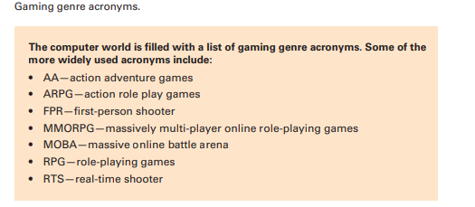

Slide 7
Some web-based game environments may involve millions of users and thousands of user-constructed “worlds,” such as schools, shopping malls, or urban neighborhoods. Game devotees may spend dozens of hours per week immersed in their virtual worlds, chatting with collaborators or negotiating with opponents. World of Warcraft (developed and published by Blizzard Entertainment) has been the mainstay and most popular of the MMORPG games with more than 5.6 million subscribers as of 2015

Slide 8
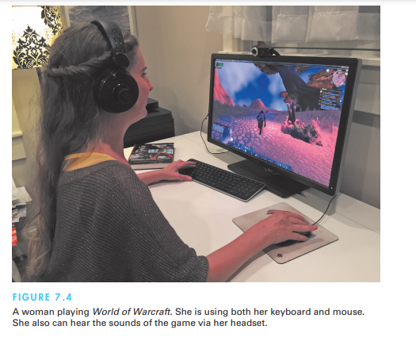

Slide 9
Most games continuously display a numeric score so that users can measure their progress and compete with their previous performance, with friends, or with the highest scorers. Typically, the 10 highest scorers get to store their initials in the game for public display. This strategy provides one form of positive reinforcement that encourages mastery. Studies with elementary-school children have shown that continuous display of scores is extremely valuable. Machine-generated feedback—such as “Very good” or “You’re doing great!

Slide 10
Computer-aided design and fabrication
Most computer-aided design (CAD) systems for automobiles, electronic circuitry, aircraft, or mechanical engineering use principles of direct manipulation. Building and home architects now have at their disposal powerful tools, provided by companies such as Autodesk, that provide components to handle structural engineering, floor plans, interiors, landscaping, plumbing, electrical installation, and much more. With such applications, the designer may see a circuit schematic on the screen and, with mouse clicks, be able to move components into or out of the proposed circuit.

Slide 11
There are large manufacturing companies using AutoCAD® and similar systems, but there are also other specialized design programs for kitchen and bathroom layouts, landscaping plans, and other homeowner-type situations. These programs allow users to control the angle of the sun during the various seasons to see the impact of the landscaping and shadows on various portions of the house. They allow users to view a kitchen layout and calculate square footage estimates for floors and countertops and even print out materials lists directly from the software.

Slide 12
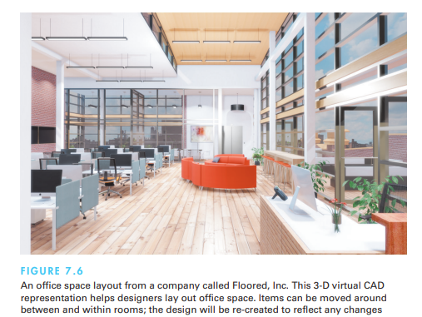

Slide 13
Another emerging use of direct manipulation involves home automation. Since so much of home control involves floor plans, direct-manipulation actions naturally take place on a display of the floor plan with selectable icons for each status indicator (such as a burglar alarm, heat sensor, or smoke detector) and for each activator (such as controls for opening and closing curtains or shades, for air conditioning and heating, or for audio and video speakers or screens). For example, users can route a recorded TV program being watched in the living room to the bedroom and kitchen by merely dragging the on-screen icon into those rooms, and they can adjust the volume by moving a marker on a linear scale. The action is usually immediate and visible and can be easily reversed as wel

Slide 14
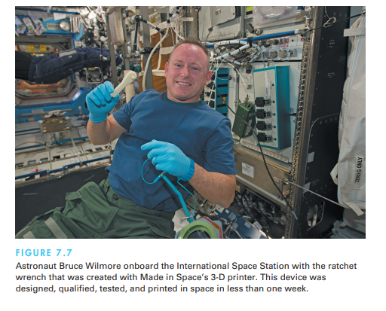

Slide 15
Direct-manipulation programming and configuration
Performing tasks by direct manipulation is not the only goal. It should be possible to do programming by direct manipulation as well, at least for certain problems. How about moving a drill press or a surgical tool through a complex series of motions that are then repeated exactly? Automobile seating positions and mirror settings can be set as a group of preferences for a particular driver and then adjusted as the driver settles in place. Likewise, some professional television-camera supports allow the operator to program a sequence of pans or zooms and then to replay it smoothly when required.

Slide 16
Programming of physical devices by direct manipulation seems quite natural, and an adequate visual representation of information may make direct manipulation programming possible in other domains. Spreadsheet packages such as Excel™ have rich programming languages and allow users to create portions of programs by carrying out standard spreadsheet actions. The result of the actions is stored in another part of the spreadsheet and can be edited, printed, and stored in a textual form. Database programs such as Access™ allow users to create buttons that when activated will set off a series of actions and commands and even generate a report. Similarly, Adobe Photoshop records a history of user actions and then allows users to create programs with action sequences and repetition using direct manipulation

Slide 17
2-D and 3-D Interfaces
some designers dream about building interfaces that approach the richness of 3-D reality. They believe that the closer the interfaces are to the real world, the easier usage will be. This extreme interpretation of direct manipulation is a dubious proposition, since user studies show that disorienting navigation, complex user actions, and annoying occlusions can slow performance in the real world as well as in 3-D interfaces (Cockburn and McKenzie, 2002). Many interfaces (sometimes called 2-D interfaces) are designed to be simpler than the real world by constraining movement, limiting interface actions, and ensuring visibility of interface objects

Slide 18
seek merely to mimic reality. For some computer-based tasks—such as medical imagery ,architectural drawing, computer-assisted design, chemical-structure modeling ,and ­scientific simulations—pure 3-D representations are clearly helpful and have become major industries. However, even in these cases, the ­successes are often due to design features that make the interface better than reality.

Slide 19
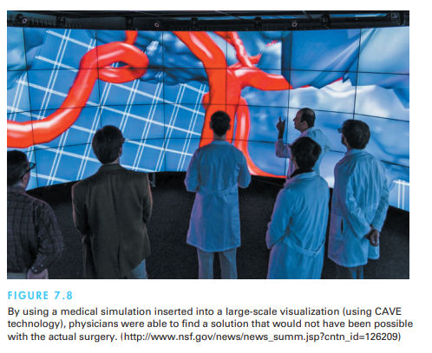

Slide 20
enumeration of features for effective 3-D interfaces might serve as a checklist for designers, researchers, and educators:
• Use occlusion, shadows, perspective, and other 3-D techniques carefully.
• Minimize the number of navigation steps required for users to accomplish their tasks.
• Keep text readable (better rendering, good contrast with background, and no more than 30-degree tilt).
• Avoid unnecessary visual clutter, distraction, contrast shifts, and reflections.
• Simplify user movement (keep movements planar, avoid surprises like going through walls).
• Prevent errors (that is, create surgical tools that cut only where needed and chemistry kits that produce only realistic molecules and safe compounds).
• Simplify object movement (facilitate docking, follow predictable paths, limit rotation).
• Organize groups of items in aligned structures to allow rapid visual search.
• Enable users to construct visual groups to support spatial recall (placing items in corners or tinted areas)

Slide 21
Breakthroughs based on clever ideas seem possible. Enriching interfaces with stereo displays, haptic feedback, and 3-D sound may yet prove beneficial in more than specialized applications. Bigger payoffs are more likely to come sooner if these guidelines for inclusion of enhanced 3-D features are followed:
• Provide overviews so users can see the big picture (plan view display, aggregated views).
• Allow teleportation (rapid context shifts by selecting destination in an overview).
• Offer x-ray vision so users can see into or beyond objects.
• Provide history keeping (recording, undoing, replaying, editing).
• Permit rich user actions on objects (save, copy, annotate, share, send).

Slide 22
Enable remote collaboration (synchronous, asynchronous).
• Give users control over explanatory text (pop-up, floating, or excentric labels and screen tips) and let them view details on demand.
• Offer tools to select, mark, and measure.
• Implement dynamic queries to rapidly filter out unneeded items.
• Support semantic zooming and movement (simple action brings object front and center and reveals more details)
• Enable landmarks to show themselves even at a distance.
• Allow multiple coordinated views (users can be in more than one place at a time and see data in more than one arrangement at a time).
• Develop novel 3-D icons to represent concepts that are more recognizable and memorable.

Slide 23
Teleoperation and Presence
Teleoperation has two parents: direct manipulation in personal computers and process control, where human operators control physical processes in complex environments. Typical tasks are operating power or chemical plants, controlling manufacturing, surgery, flying airplanes or drones, or steering vehicles. If the physical processes take place in a remote location, we talk about teleoperation or remote control. To perform the control task remotely, the human operator may interact with a computer, which may carry out some of the control tasks without any interference by the human operator.

Slide 24
There are great opportunities for the remote control or tele operation of devices if acceptable user interfaces can be constructed. When designers can provide adequate feedback in sufficient time to permit effective decision making, attractive applications in manufacturing, medicine, military operations, and computer-supported collaborative work are viable. Home-automation applications extend remote operation of various devices to security and access systems, energy control, and operation of appliances. Scientific applications in space, underwater, or in hostile environments enable new research projects to be conducted economically and safely. The recent introduction of affordable drones will be yet another facet of tele operation.

Slide 25
A typical remote application is telemedicine, or medical care delivered over communication links (Sonnenwald et al., 2014). Telemedicine can be used more broadly to allow physicians to examine patients remotely and surgeons to carry out operations across continents. Telehealth is being widely used in the Veteran’s Administration Veterans can come into the local VA office where technology visits with the various medical personnel can be conducted via Telehealth.

Slide 26
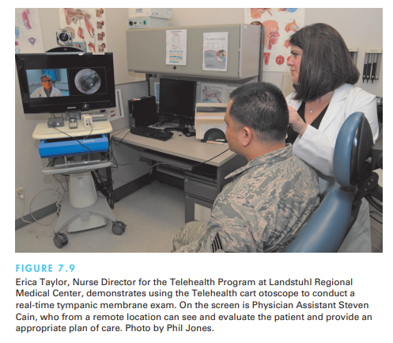

Slide 27
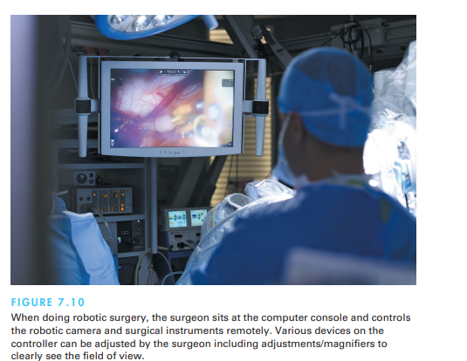

Slide 28
The architecture of remote environments introduces several complicating factors:
Time delays. The network hardware and software cause delays in sending user actions and receiving feedback: a transmission delay, or the time it takes for the command to reach the microscope (in our example, transmitting the command over the network), and an operation delay, or the time until the microscope responds. These delays in the system prevent the operator from knowing the current status of the system.
• Incomplete feedback. Devices originally designed for direct control may not have adequate sensors or status indicators. For instance, the microscope can transmit its current position, but it operates so slowly that it does not indicate the exact current position.
• Unanticipated interferences. Since the operated devices are remote, unanticipated interferences are more likely to occur than with physically present direct-manipulation environments

Slide 29
One solution to these problems is to make explicit the network delays and breakdowns as part of the system. The user sees a model of the starting state of the system, the action that has been initiated, and the current state of the system as it carries out the action. It may be preferable for users to specify a destination (rather than a motion) and wait until the action is completed before readjusting the destination if necessary. Avenues for continuous feedback also are important.
Teleoperation is also commonly used by the military and by civilian space projects. Military applications for unmanned aircraft gained visibility during the recent wars in Afghanistan and Iraq. Reconnaissance drones and teleoperated missile-firing aircraft were widely used. Agile and flexible mobile robots exist for many hazardous duty situations (Murphy, 2014). Military missions and harsh environments, such as undersea and space exploration, are strong drivers for improved designs.

Slide 30
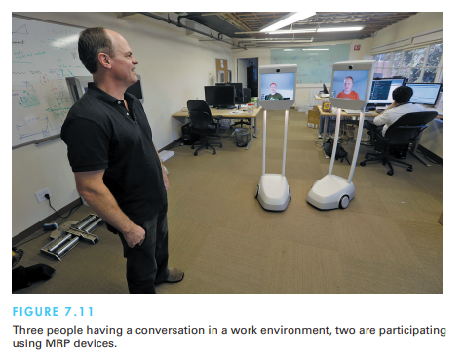

Slide 31
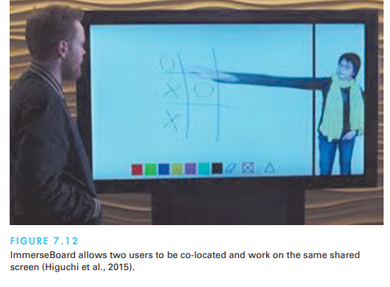

Slide 32
Augmented and Virtual Reality
Flight-simulator designers work hard to create the most realistic experience for fighter and airline pilots. The cockpit displays and controls are taken from the same production line that creates the real ones. Then the windows are replaced by high-resolution computer displays, and sounds are choreographed to give the impression of engine start or reverse thrust. Finally, the vibration and tilting during climbing or turning are created by hydraulic jacks and intricate suspension systems. This elaborate technology may cost $100 million, but even so, it is a lot cheaper, safer, and more useful for training than the $400-million jet that it simulates.

Slide 33
Flying a plane is a complicated and specialized skill, but simulators are available for more common—and some surprising—tasks under the alluring name of virtual reality or the more descriptive virtual environments.

Slide 34
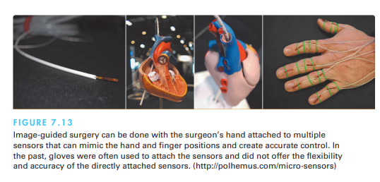

Slide 35
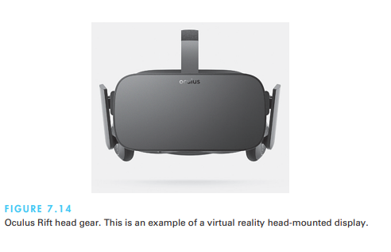

Slide 36
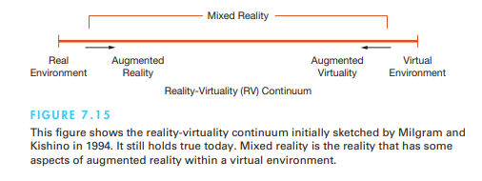

Slide 37
Augmented reality
Augmented reality enables users to see the real world with an overlay of additional information; for example, while users are looking at the walls of a building, their semitransparent eyeglasses may show the location of electrical wires and studwork. Medical applications, such as allowing surgeons or their assistants to look at patient while they see an overlay of a sonogram or other pertinent information to help locate a tumor, also seem compelling

Slide 38
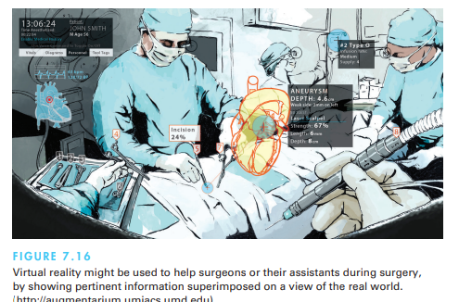

Slide 39
An interior designer walking through a house with a client should be able to pick up a window-stretching tool or pull on a handle to try out a larger window or to use a room-painting tool to change the wall colors while leaving the windows and furniture untouched. Companies like IKEA are providing augmented reality tools so customers can visualize the products via their catalog in their own homes and rooms

Slide 40
Virtual reality
The presence aspect of virtual reality breaks the physical limitations of space and allows users to act as though they are somewhere else. Practical thinkers immediately grasp the connection to remote direct manipulation, remote control, and remote vision, but the fantasists see the potential to escap reality and to visit science-fiction worlds, cartoonlands, previous times in history, galaxies with different laws of physics, or unexplored emotional territories e current

Slide 41
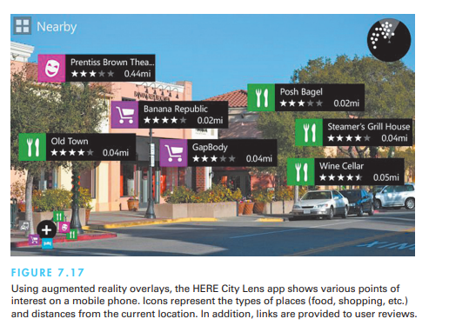

Slide 42
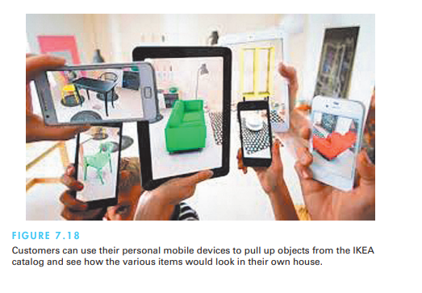

Slide 43
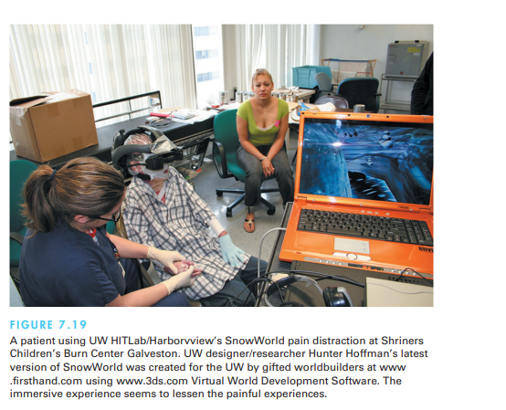

Slide 44
